Slide 1
Quiz Dubai - November 2021

Slide 3

General Rules
23 questions (across two halves)
Infinite bounce + pounce
+10 on bounce (part points will be given for multi-part questions)
+10 / -10 on pounce
On each question slide, in the top right corner is a pounce timer
Timer will be started once the question has been read out/visuals shown and will run for 60 seconds.
No need to announce you are pouncing - just send answer over Zoom chat. If answer is not received when timer ends, your team will be deemed to have not pounced
Questions designed to be workable (we hope!) – so please guess! ☺

Slide 4
Clockwise

Slide 5
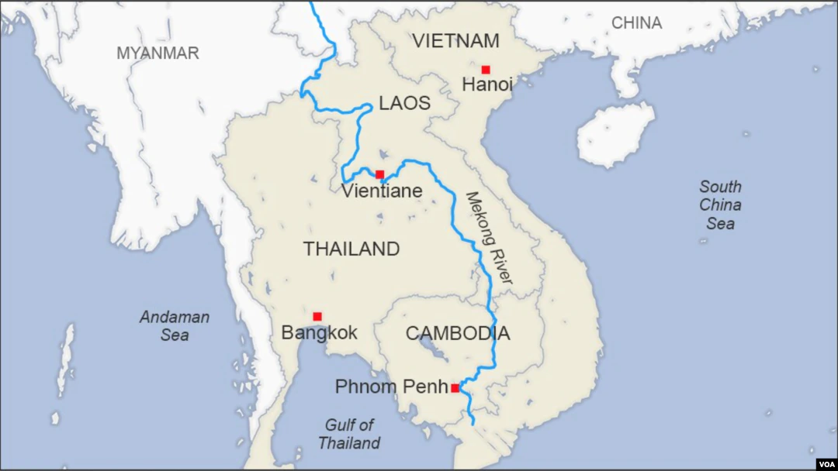
Historically, the term refoulement - derived from the French refouler, meaning to “force back” - referred to the phenomenon of reversed flow in the rising waters of the Mekong river during the monsoon. In 1951, inspired by this history, a landmark treaty of international law imposed an obligation called non-refoulement on all nations. Coincidentally, the 1970s saw this mandate being widely employed to assist people across the Mekong countries. What does non-refoulement entail? (5)
To support beneficiaries of refoulement protections, the Indian government collected a 5 paise surcharge on all mail for a two-year period. Postmasters were instructed to annotate stamps that were already in circulation to reflect this newly added charge. When and who were the beneficiaries? (5)
1

Slide 6
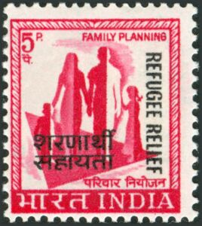
1

Slide 7
Answer is. . .

Slide 8
Non-refoulement is the obligation of countries not to force back refugees to their home countries if they have a fear of persecution.
The stamps were issued between 1971 and 1973 to support refugees from Bangladesh.
1

Slide 9
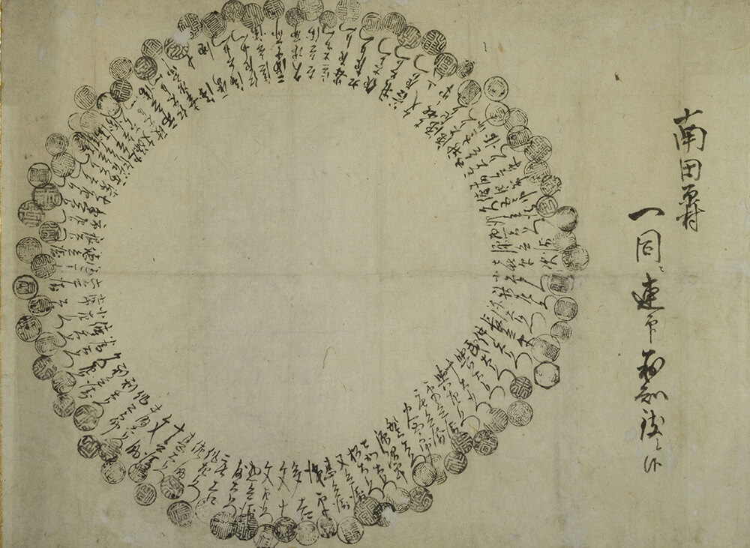
2

Slide 10
In the mid 1600s, during the early Edo Period in Japan, impoverished peasants registered their grievances against feudal lords (daimyo) by signing ‘umbrella-style joint covenants’. There were two reasons for this. One was to express their unity. What was the second reason? (5)
Around the same time, Portuguese missionaries began arriving in Nagasaki. They brought a dish called peixinhos da horta, meaning ‘little fish of the garden’, comprising battered and fried green beans. This was usually eaten by poor people, who often could not afford meat, but it proved a convenient meal for these missionaries during a certain ‘time’ of the year. The Japanese then innovated on this dish and gave it a new name. How do we know this dish today, and what was the ‘time’ of year? (5)
2

Slide 11
Answer is...
2

Slide 12
Since everyone had signed in a circle, the feudal lords could not identify the leaders of the movement.
This dish became tempura. During Lent, the missionaries had to abstain from meat, so they often ate this dish. Tempura likely gets its name from the Portuguese term for the Ember Days of Lent, Tempora, which in turn likely comes from the Latin term ad tempora quadragesima. All, of course, referring to ‘time’.
2

Slide 13
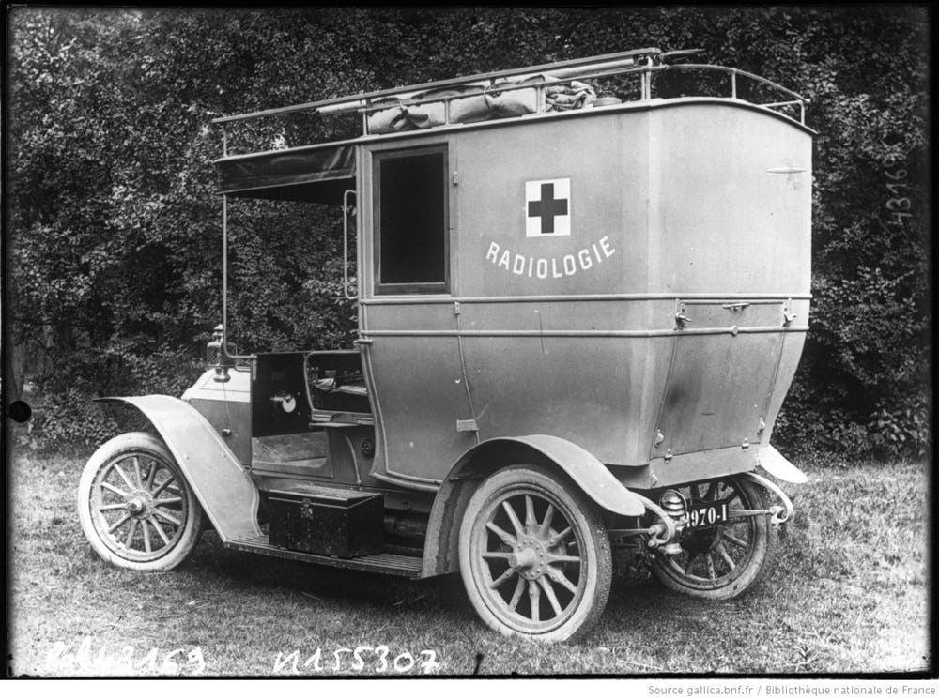
To aid surgeons on the WWI front lines, X, on hiatus from their day job, invented a mobile, electricity-based solution by fitting cars with dynamos. To provide skilled operators, X trained recruits on the physics of electricity and on human anatomy. ID X and the invention? (5)
X wrote about health risks from operating this invention. Researchers have relied on these writings and related evidence to push back on a popular but apocryphal theory on X’s own health. What theory? (5)
3

Slide 14
Answer is...
3

Slide 15
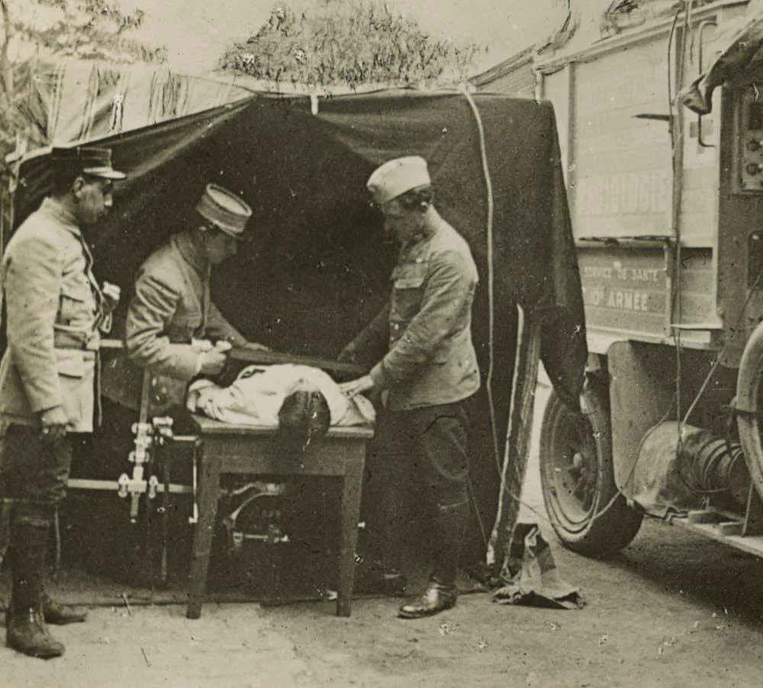
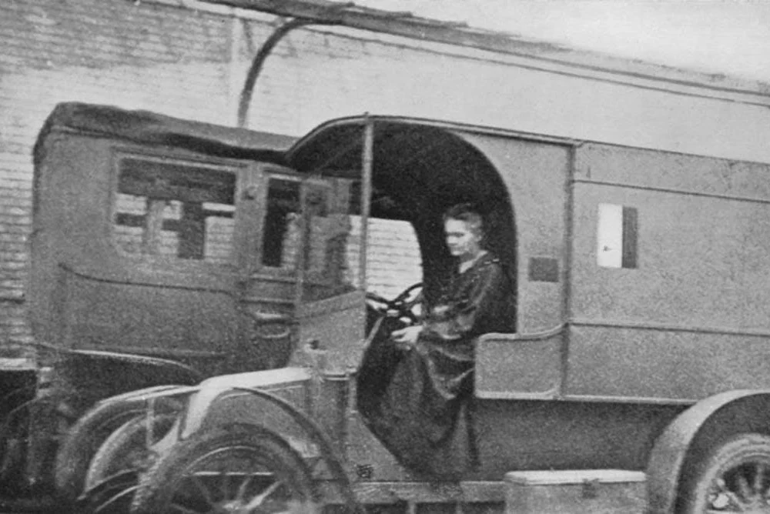
X = Marie Curie, and the invention is the mobile X-ray unit.
The theory is that Marie Curie suffered radiation poisoning, and eventually died, because of having ingested/had prolonged exposure to radium. It is more likely her illness was brought on by constant exposure to X-rays, as she herself noted in her private diaries. A sampling of her body in 1995 showed it free of radium.
3

Slide 16
Kharai camels are a breed found primarily in the Kutch region. Kharai comes from the local word for saline, a reference to their diet of mangrove and other saline-loving plants, found on the forested islands along the Arabian Sea coast. To feed themselves, Kharai camels exhibit a behavior unique among camels. What behaviour? (5)
The Jat community in Kutch has long nurtured these camels, relying on them for economic sustenance. Since 2019, they have benefited from a certain company’s commercialization of a product that is a part of their daily lives, but new to urban consumers. What company, and what is the product? (5)
4

Slide 17
Answer is. . .
4

Slide 18

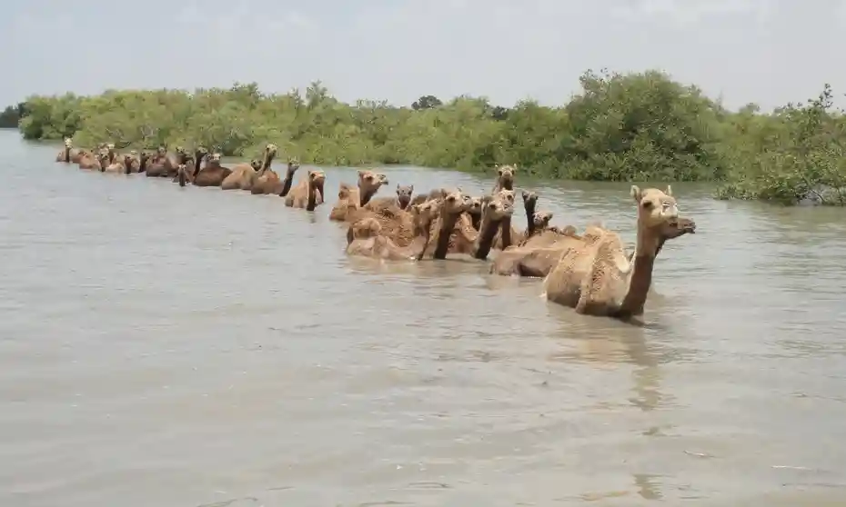
4

Slide 19
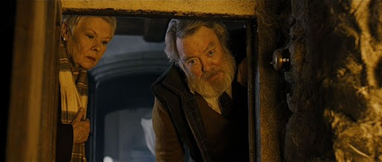
5

Slide 20
In 16th century England, a network of homes - apparently including Skyfall - was fitted with underground holes, usually hidden by contraptions like false walls and staircases. The homes themselves were typically marked with wax seals featuring a lamb. What purpose did these holes serve? (5)
On June 20 1756, the troops of Nawab Siraj-ud-dawlah, having just taken over Calcutta from the EEIC, imprisoned Company POWs overnight in a tiny lockup room at Fort William. What followed was morbid: a British estimate suggests that just 23 out of 146 survived the night, while a later Indian estimate suggests it was 21 out of 64. This incident gained a moniker that in the 1960s inspired a new term in physics. What moniker/what physics term? (5)
5

Slide 21
Answer is...
5

Slide 22
The holes were called priest holes, and they were used to hide Catholic priests during the Protestant Reformation. Under Queen Elizabeth I, Catholicism was outlawed in England, and priests were punished by death. Headhunters were sent to find and rein in Catholic priests, so a network of safe houses developed to hide them.
This morbid incident became known as the Black Hole of Calcutta, and eventually found its way into the physics lexicon. The first known use of the term is from 1957, when Robert Dicke, presenting a talk about early research into singular points so gravitationally intense that light could not escape, jokingly added it was ‘like the Black Hole of Calcutta’. The term was eventually popularized in 1967 by John Wheeler.
5

Slide 23
In the 1930-50s, National Comics (later DC Comics) saw many attempts to imitate the Superman character, including by Fawcett Comics. A court eventually ruled that Fawcett’s character (X) was an imitation of Superman, forcing Fawcett to shut down the series. Amusingly, DC purchased the rights to X from Fawcett in the 1970s. However, they had to rebrand the character as Shazam, due to concerns over infringing a different competitor’s IP. ID X, and why did DC rebrand the comics Shazam? (5)
As part of the Fawcett dispute, National initially suffered a setback when a court ruled that they had no IP in Superman, because of negligence by National’s print partner, McClure Syndicate, on certain strips. What was McClure’s negligence, visible on the first box of the strip? (5)
6

Slide 24
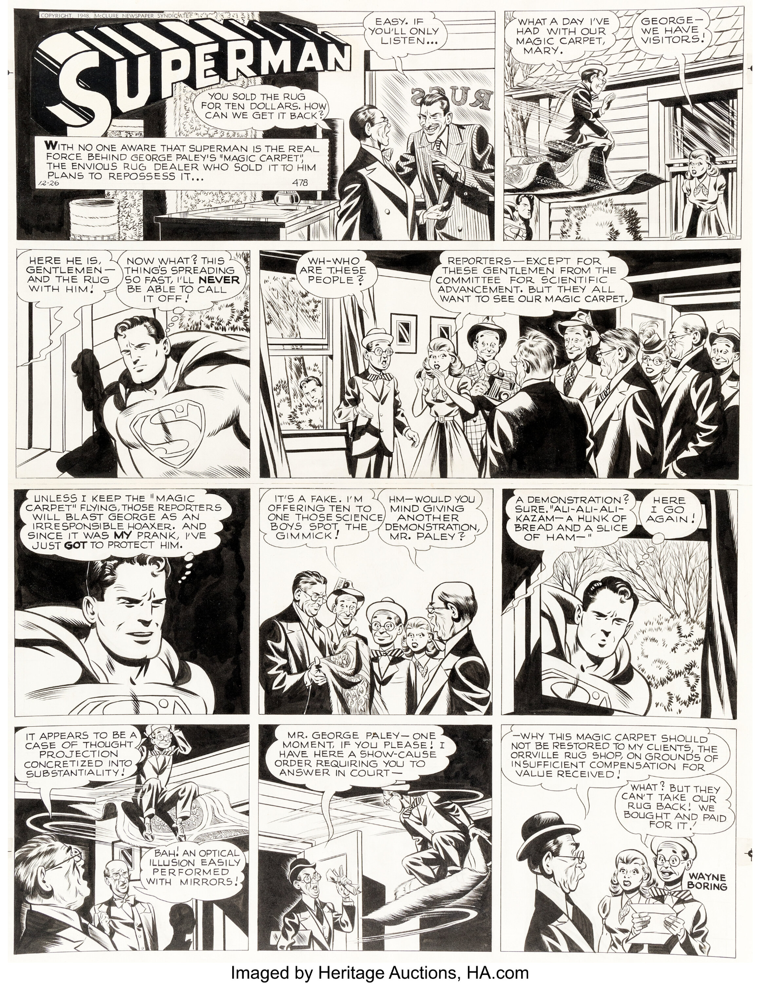
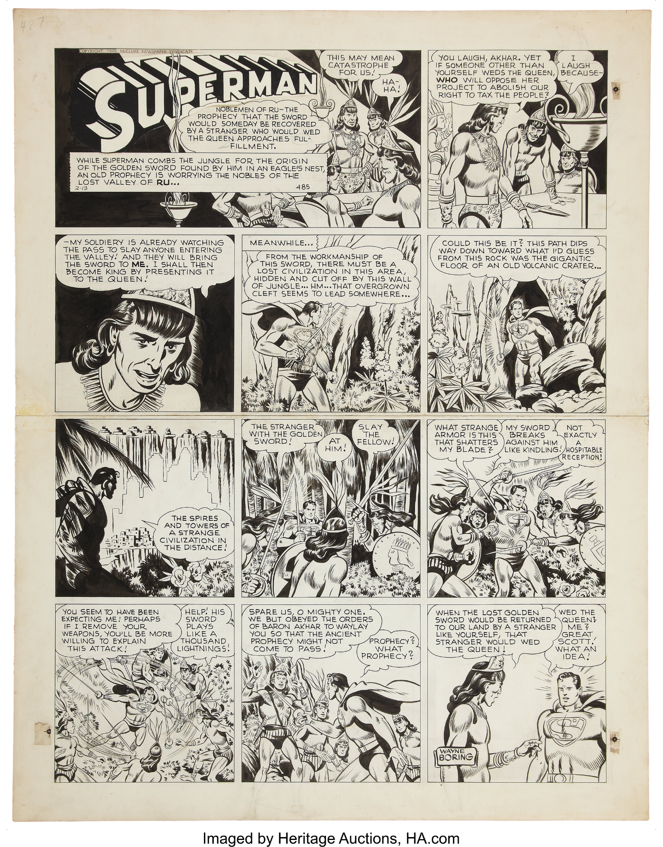
6
ID X, and why did DC rebrand the comics Shazam? (5)
What was McClure’s negligence, visible on the first box of the strip? (5)

Slide 25
Answer is. . .
6

Slide 26
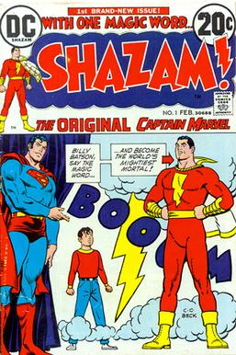
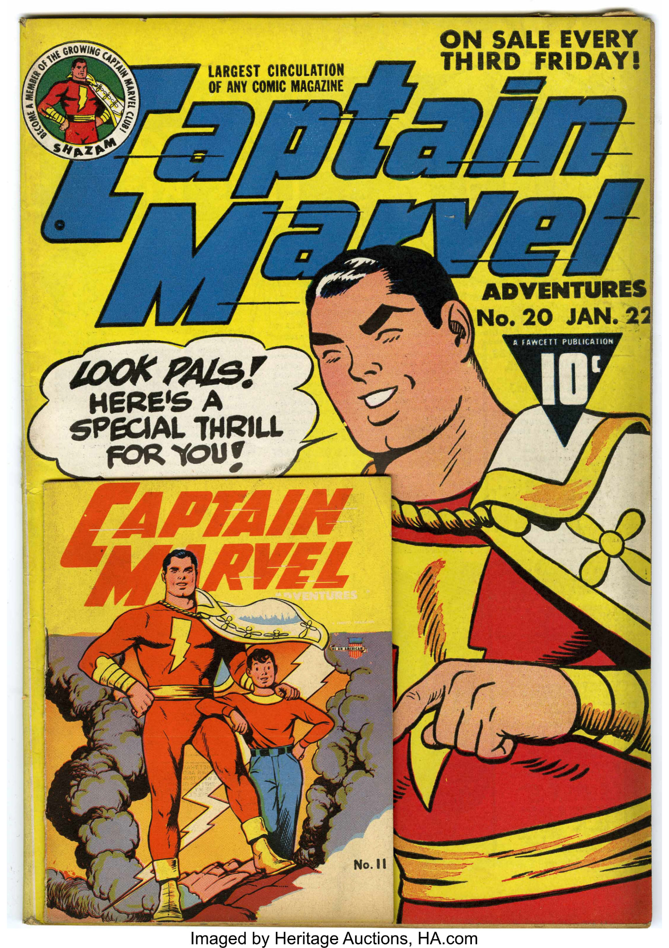

X is Captain Marvel. When Fawcett lost the lawsuit, they stopped publishing Captain Marvel. In 1967, Marvel registered a trademark on the same name, meaning DC had to rename their character to Shazam when they revived the line in the 1970s.
6

Slide 27
McClure neglected to include a copyright mark on many of the strips they published.
6

Slide 28
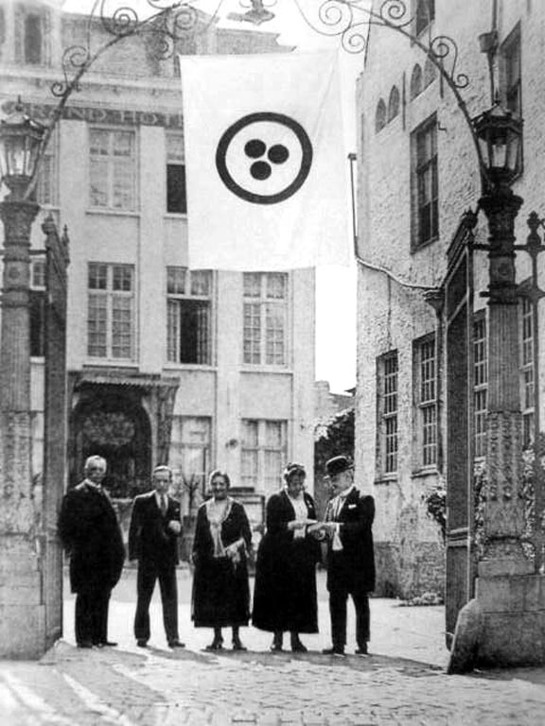
Nicholas and Helena Roerich created a series of architectural paintings while touring 40 ancient Russian cities in 1903. Many of these locations were ravaged by the Russo-Japanese War, leaving the paintings as the only archive.
To prevent a repeat, the Roerichs persuaded world powers to join the Roerich Pact in 1930, notably introducing the Banner of Peace.
What was the goal of the Roerich Pact, and how does the Banner of Peace help achieve it? (10)
7

Slide 29
Answer is...
7

Slide 30
The Roerich Pact was aimed at protecting cultural heritage sites from destruction or damage during armed conflict. The Banner of Peace was to be flown or attached to the top of monuments so that air and ground troops would be able to identify what monuments to protect.
The Roerich Pact was superseded after World War II by the Hague Convention for the Protection of Cultural Property in the Event of Armed Conflict and the creation of UNESCO.
7

Slide 31
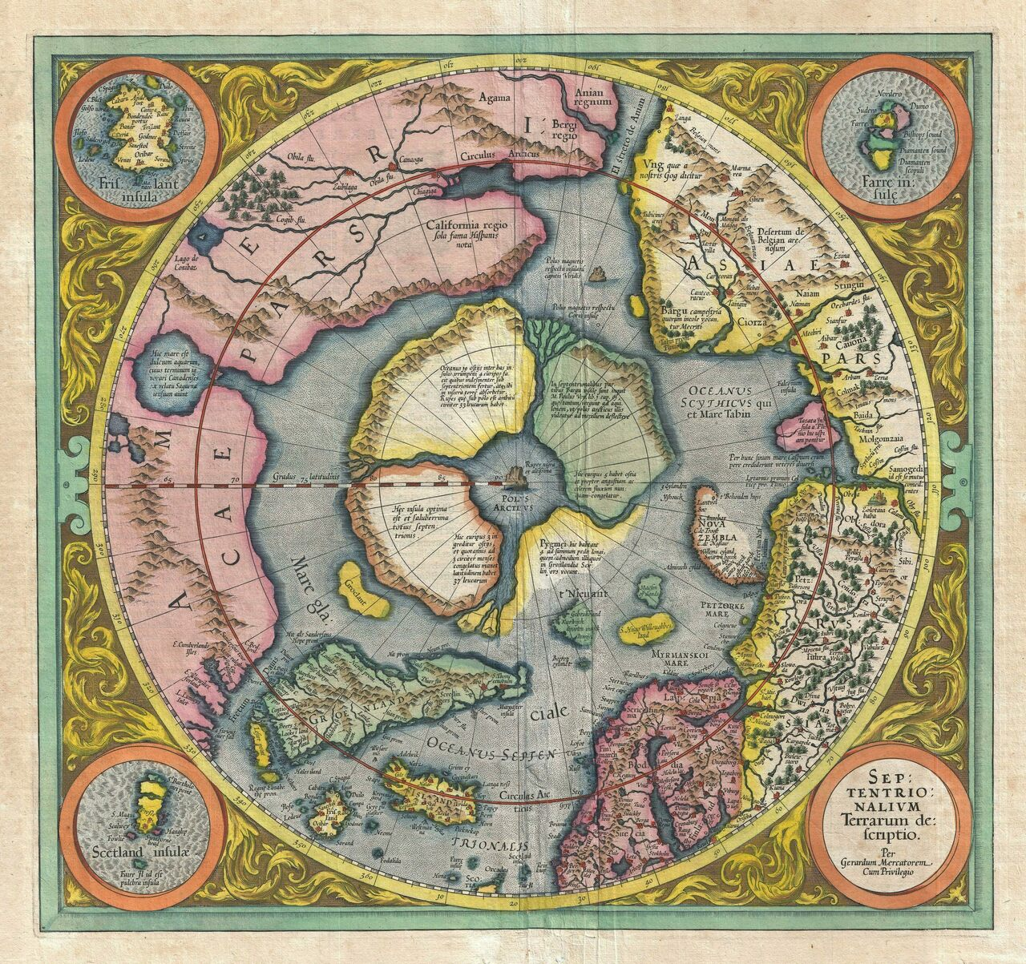
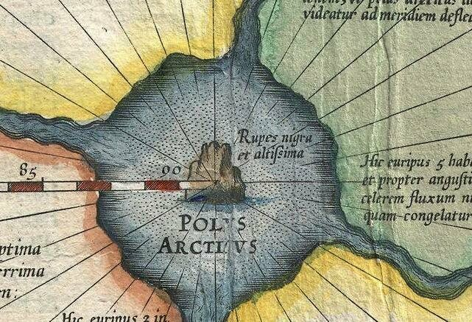
Septentrionalium Terrarum by Mercator and his proteges
8
X

Slide 32
Mapmaker Gerardus Mercator’s Septentrionalium Terrarum (1606) was one of the first maps to depict X. Little was known about X at the time, but it was widely believed that it was a magnetic mountain (as Mercator depicts it). This provided an easy explanation for why a certain tool behaved the way it did. ID X, and what was the tool and explanation? (5)
Mercator famously made a world map in 1569, using the Mercator projection that is still in use today. Primarily built for navigation, the 1569 map positioned land masses accurately direction-wise but introduces other distortions. This made it impossible to depict X on that map. Why was it not possible to depict X on the 1569 map? (5)
8
X

Slide 33
Answer is...
8

Slide 34
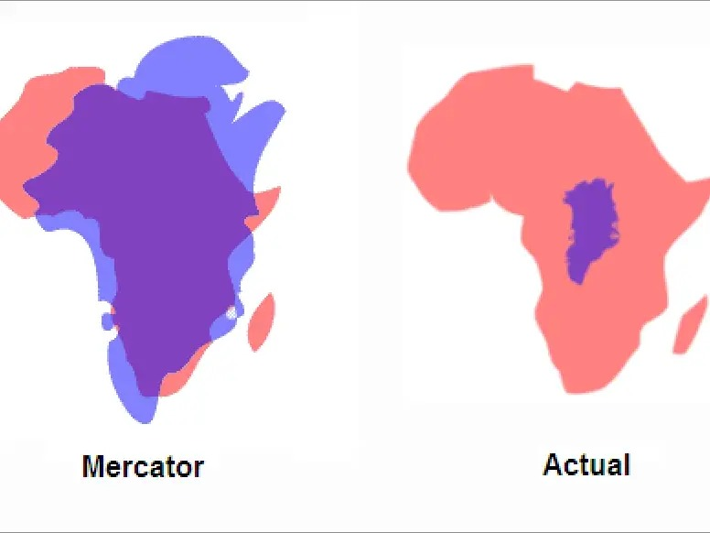
X = North Pole. The tool is the compass, which was believed to point due north as there was a magnetic rock in the north.
To preserve directional accuracy, the Mercator projection increases the area of a landmass as you move away from the equator. The north pole would have been infinitely sized in this projection.
This continues to be a problem with interpreting geography using maps, as landmasses further away from the equator show up much larger than they are vis-a-vis lands closer than the equator.
8

Slide 35
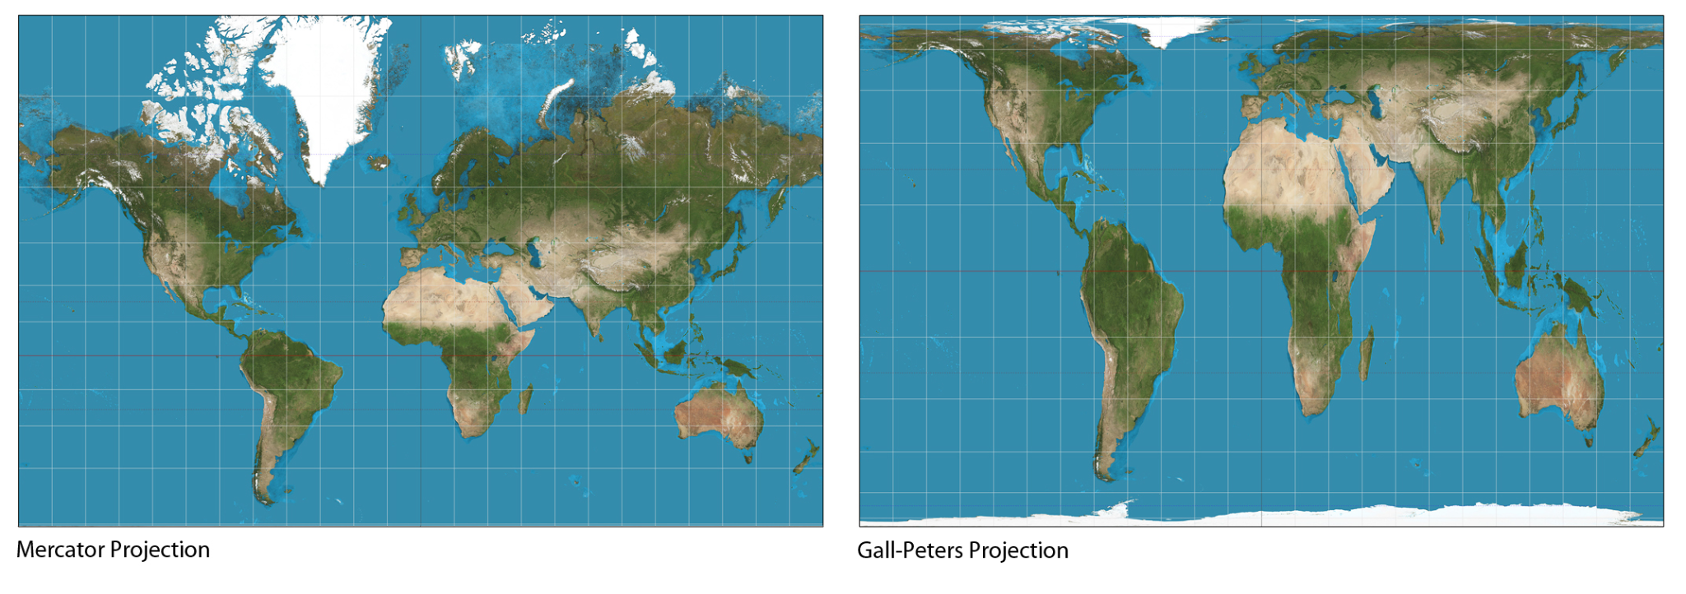
8

Slide 36
Having observed that staining dyes worked selectively on lab cell samples, Paul Ehrlich was inspired to find drugs that were similarly selective: ‘magic bullet’ molecules that reacted with and delivered toxins only to pathogens but left the body healthy. Ehrlich gave this approach a name that is today synonymous with treatment for a particular disease. What name? (5)
In 1899, Ehrlich discovered that when a water-soluble dye was injected into the bloodstream of a mouse, all of its organs were stained except one. In 1913, his student Edwin Goldmann found that when the dye was injected directly into this organ, it alone picked up the stain: no other body tissue did. What phenomenon, which continues to pose a challenge to drug development, did these findings first illuminate? (5)
9

Slide 37
Answer is...
9

Slide 38
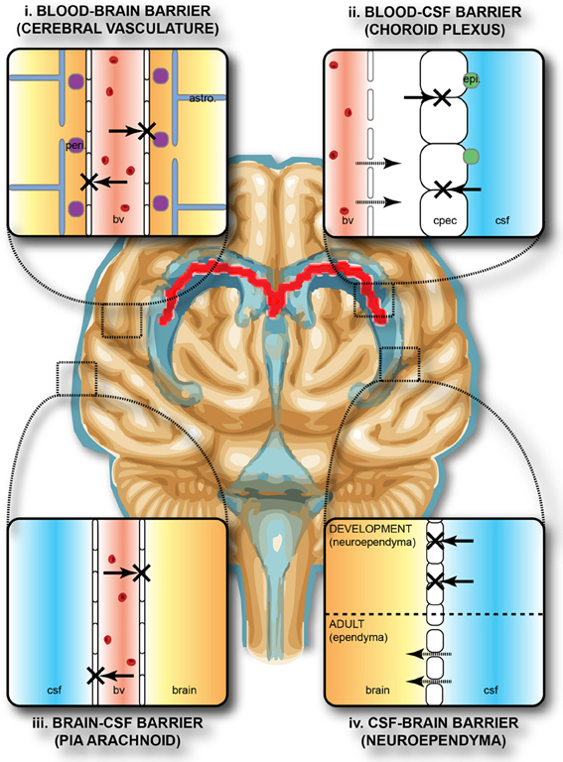
Chemotherapy. Ehrlich won the 1908 Physiology Nobel for this work. His original intent is reflected in modern day cancer-therapeutic chemotherapy.
Ehrlich and Goldmann were among the first to stumble upon the Blood-Brain Barrier (BBB): the blood vessels and tissue that prevent most molecules from reaching the brain. This protects the brain from harmful substances. But it also prevents drug molecules from reaching the brain, making it very difficult to design therapies for brain diseases.
Ehrlich himself is believed to have been skeptical of the idea. Much of the pioneering work on the BBB came in the 1920s from Lina Stern.
9

Slide 39

10

Slide 40
Umm Kulthum, “The Voice of Egypt” was Egypt’s premier singer of the 20th century. She shared a close friendship with Gamal Abdel Nasser, in whose support she sang many songs. Despite local and overseas acclaim, her musical choices caused consternation amongst traditionalists in the Arabic music community. Why did she face pushback from traditionalists? (5)
When once asked what her favorite landmark in France was, Umm Kulthum replied X - understandable given her political leanings. In the rush to install X, it was oriented incorrectly, with a sign today guiding visitors noting “My Thebes East is my Paris North.” In 1999, X was also be used as the gnomon for a functioning sundial. ID X. (5)
10

Slide 41
Answer is...
10

Slide 42
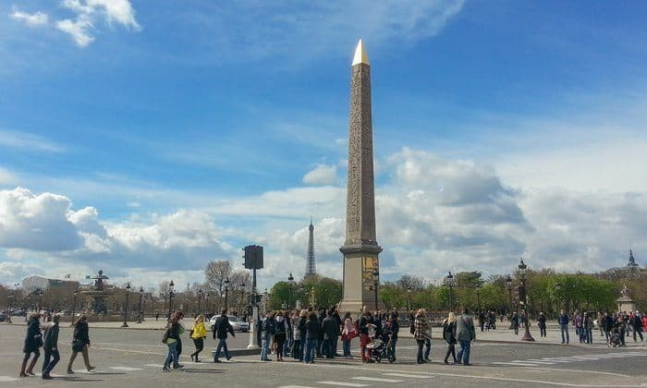
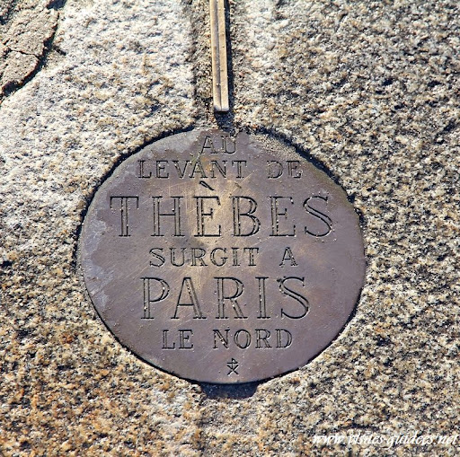
She faced pushback for the use of Western instruments in the ensemble for her performances
X = The Luxor Obelisk at Place de la Concorde
10

Slide 43
During the Great Game, the British trained Indian surveyors (pundits) to calibrate and count their paces, so they could discreetly survey lands.
Through the 1860s, the pundit Nain Singh determined the location of Lhasa and mapped the Tibetan highlands. During these expeditions, the British equipped him with a modified version of an everyday object, to help him both blend in and measure distances. What object? (5)
In the 1880s, to validate a hypothesis, the British tasked the pundit Kinthup with verifying a route. He trekked up the Tibetan plateau, where, in coordination with British officials in Bengal, he was to release 500 specially marked logs. What was Kinthup supposed to prove? (5)
11

Slide 44
Answer is. . .
11

Slide 45
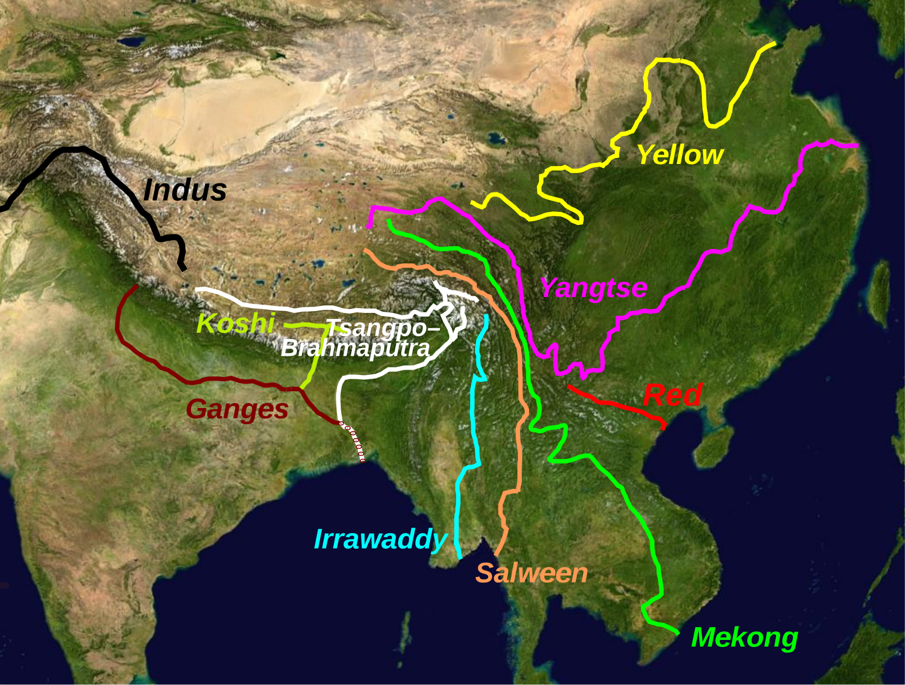
Nain Singh was given a modified japamala, or rosary, so he could count his paces and pass off as an ordinary Buddhist monk in Tibet. Unlike a normal japamala which has 108 beads, this one had 100, to make the mathematics of measuring distance easier.
Kinthup was tasked with verifying if the Tsangpo river fed into/became the Brahmaputra downstream. He was supposed to the float the logs down the Tsangpo: the British officials would have spotted them downstream.
11

Slide 46
Polymerase chain reaction, or PCR, is an iterative technique invented in 1983 to make billions of copies of a single DNA sample. In COVID testing, PCR is used to amplify a coronavirus DNA target so it is easily detected.
Loop-mediated isothermal amplification, or LAMP, is another technique invented in 2002 to amplify DNA. Increasingly, LAMP is finding use in COVID testing. Unlike PCR tests, LAMP tests are cheap and quick: they require a single vessel and give results in under 30 minutes.
What is the key difference between these two techniques, that explains why LAMP testing is easier than PCR testing? (10)
12

Slide 47
PCR needs fluctuating temperatures, while LAMP only needs a constant temperature.
PCR involves iterating between heating and cooling cycles to induce DNA melting and replication respectively. This is why PCR needs a specialized thermal cycling machine.
LAMP, as the name suggests, is iso-thermal. It amplifies DNA at a constant temperature, typically around 65C.
12

Slide 48
Break
Counter-clockwise on return

Slide 49
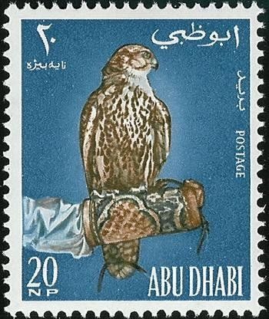
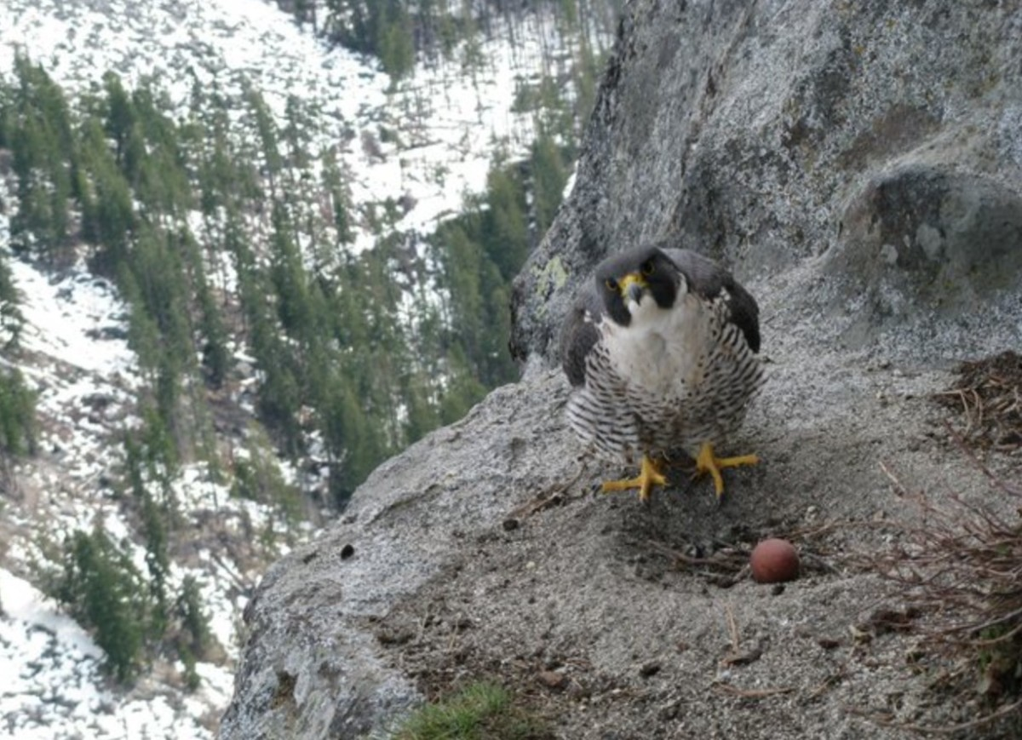
13

Slide 50
Bird catchers ordinarily capture birds near their nest, but peregrine falcon nests are inaccessible to humans. To reflect the circumstances under which these birds were caught, the falcons were called peregrines, deriving from the Latin root word for “pilgrim”. What were these circumstances? (5)
In 1957, country X introduced “NP” - a domestic policy change that impacted Abu Dhabi. To reflect this change, NP was “newly” added to Abu Dhabi, including on its stamps printed in the early 1960s. In 1965, X replaced NP domestically. In response, while Abu Dhabi ceased printing NP stamps, it did not incorporate X’s replacement anywhere else. What was NP? Why was the conforming change not added to future stamps? (5)
13

Slide 51
Answer is...
13

Slide 52
The peregrine falcon was caught during its seasonal migration to and from its nesting grounds.
NP stood for Naya Paisa - reflecting the decimalization
of INR for the first time. From 1959 - 1966,
many states in the Middle East used the Gulf Rupee as
their official currency, which was convertible at par
to INR. In 1965-66, India (i) dropped the “naya” from
naya paisa, and (ii) devalued the Gulf Rupee vis-a-vis
INR, which led to many states in the Middle East
adopting their own currency.
13

Slide 53
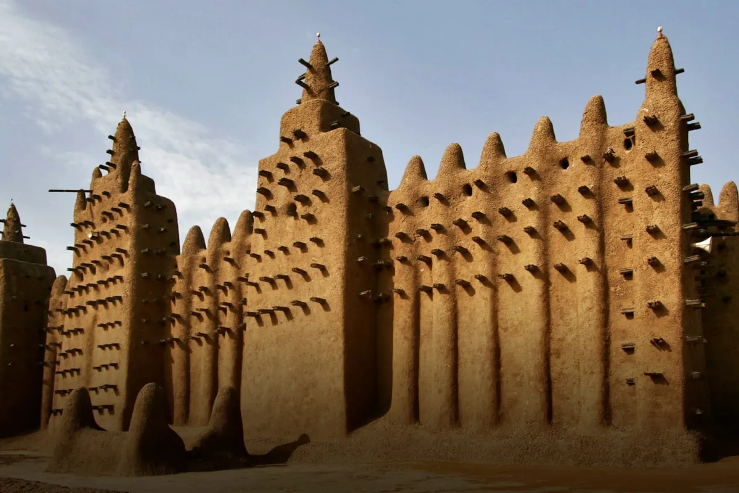
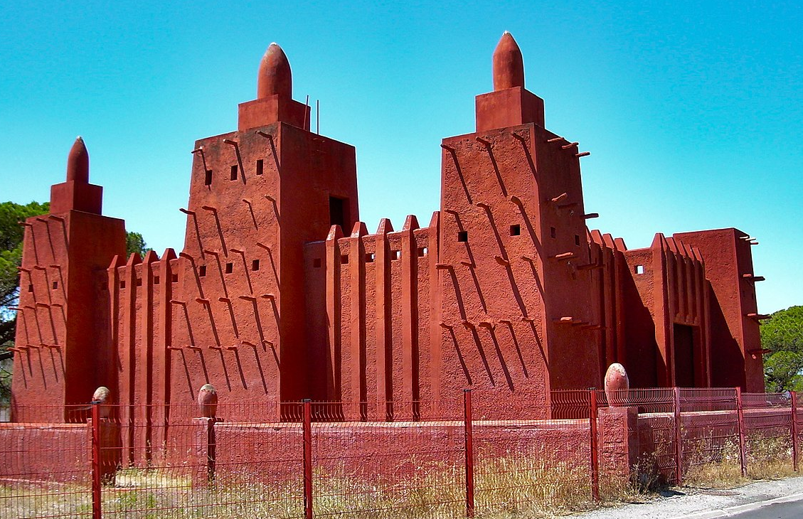
14
Grand Mosque of Djenné, Mali Missiri Mosque, Fréjus, France

Slide 54
The Grand Mosque of Djenné, situated in the floodplain of the Bani river in modern day Mali, was originally built in the 13th century out of mud brick. A striking feature is the presence of decorative toron, the sticks of rodier palm jutting out through its walls. Every April, before the rainy season, the town of Djenné celebrates a unique festival called Crépissage, where these toron prove especially useful. What happens at Crépissage every year? (5)
The Missiri Mosque, which mimics the Grand Mosque of Djenné, was built in Fréjus, France for the benefit of the Tirailleurs, many of whom came to France in 1915. To stave off feelings of isolation among the Tirailleurs as they stayed on, French authorities constructed what they thought would be a familiar social space. Who or what were the Tirailleurs? (5)
14

Slide 55
Answer is. . .
14

Slide 56
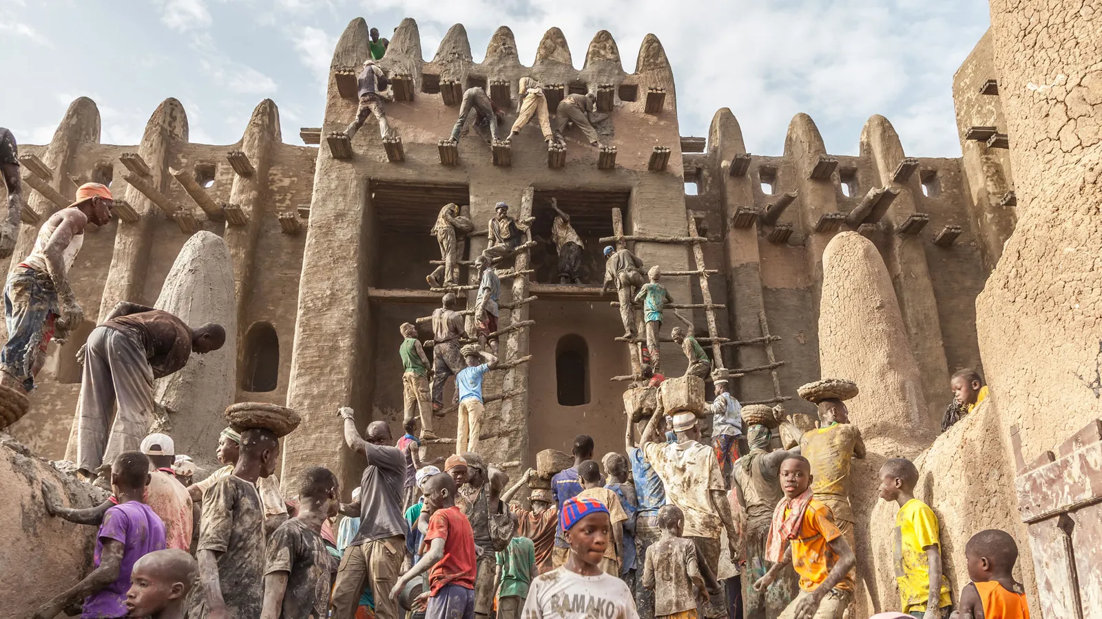
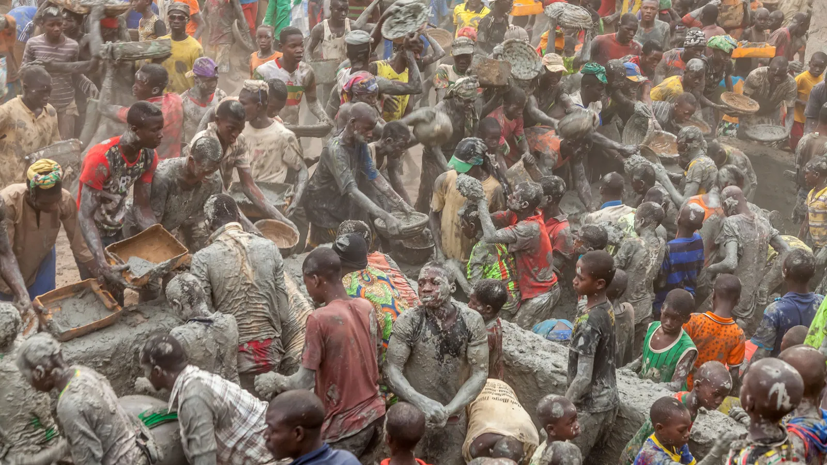
Crépissage is the festival of replastering the mosque to protect the mud-brick from erosion by the rains and floods. Also a major tourist attraction these days.
The Tirailleurs were regiments of soldiers recruited from French colonies in Africa.
14

Slide 57

15

Slide 58
Los Angeles 1984 was the first Olympic Games to make a profit. A driver behind its economic success was a policy change (that remains active to date) from the International Olympic Committee, making corporate partnerships more lucrative for the IOC and host cities.
This policy change also explains why the previous ad by Nike was designed in the way it was.
What was the policy change? (10)
15

Slide 59
Answer is. . .
15

Slide 60
The Olympic Games introduced exclusive partnership deals for the first time in 1984. Rather than accepting a wide variety of sponsors (as previous Games had done) suppliers and licensees, LA 1984 strictly limited the number “official” sponsors, and required sponsors to make much larger contributions to the Games than in previous years in return for exclusive association with the Olympics.
Nike was not an official sponsor for the 2012 Olympics - and therefore was barred from using “London, UK” or “2012” in any marketing - which is why they rely on cities across the world named London.
15

Slide 61

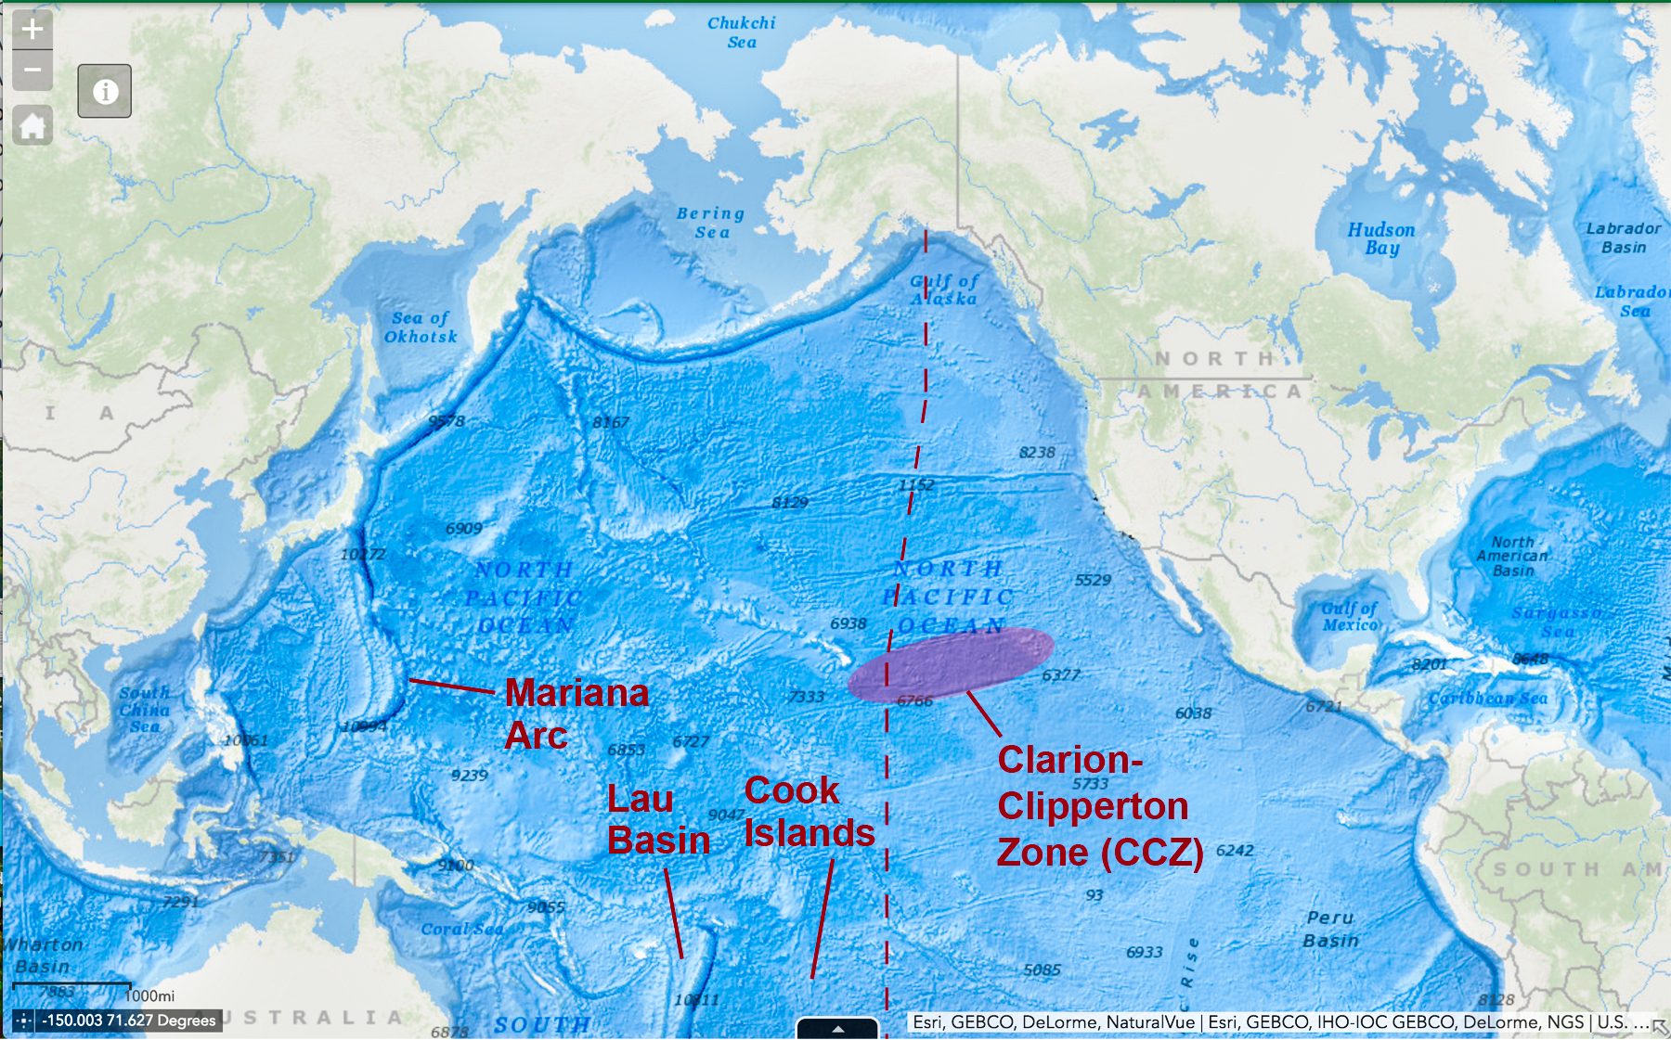
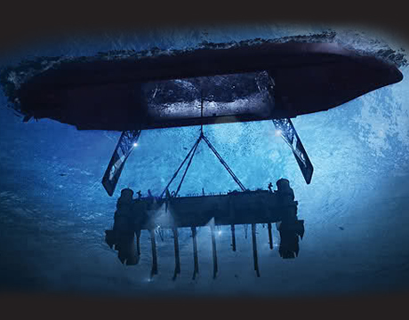
16

Slide 62
Azorian was a 1970s U.S. government operation to build the Glomar Explorer, to be deployed in the Clarion-Clipperton Zone. While the Glomar looked like a standard ship from the top, it had a moon pool capable of deploying the chassis shown. It was designed to deliberately obscure the true intentions of the ship to casual onlookers. Why was the ship built? (5)
To provide a cover story, the U.S. said that the ship would be the first to attempt a certain activity (and pioneer the related industry). In reality, this activity was first completed by Japan in 2017. Viewed as the keys to a “treasure map”, what is the activity in question, which is poised for growth in the years to come? (5)
15
16

Slide 63
Answer is...
15
16

Slide 64
The ship was built to recover the K-129, a G-II class Soviet submarine carrying 3 nuclear ballistic missiles, that had vanished on patrol in the Pacific. In 1974, the Hughes Glomar Explorer raised part of the K-129 into its hull. But the wreck broke apart during the operation and they recovered only a portion of the bow. They did not get the missiles. Moreover, the Soviets knew what was up pretty much immediately hey had patrol boats watching the operation, from a distance.
The activity was seabed mining. The U.S. funded a series of academic working groups to develop economic analyses of seabed resources, and aimed to recover polymetallic nodules from the seabed. These nodules are attracting renewed interest since they are rich in cobalt and nickel.
15
16

Slide 65
In 1802, a German schoolteacher named Georg Grotefend made a huge leap in deciphering cuneiform, the writing system used in ancient Mesopotamia. Grotefend noted that two inscriptions from Persepolis started with the same pattern: the same string of symbols repeating itself twice, separated by what appeared to be a backtick.
Based on his knowledge of later Persian, he correctly guessed that this sequence was an introductory honorific. From this insight, he (and others) inductively deduced the interpretation of many other cuneiform symbols.
What does this sequence mean or translate to? (10) In a different context, the answer may also be also familiar to 1980s Bollywood fans.
16
17

Slide 66
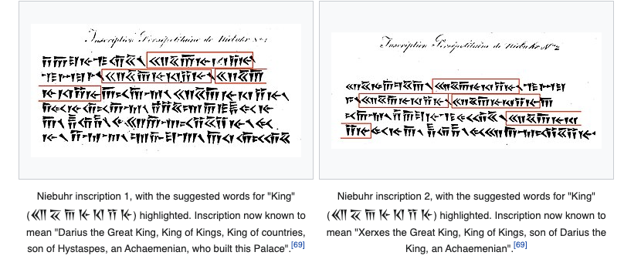
What does this sequence (in the consecutive red boxes), representing a honorific, mean or translate to? (10)
16
17

Slide 67
Answer is. . .
16
17

Slide 68
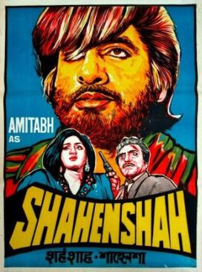
King of Kings - or Shahenshah. (The old Persian word for king was kshatiya, similar perhaps to kshatriya, which then became shah.)
16
17

Slide 69
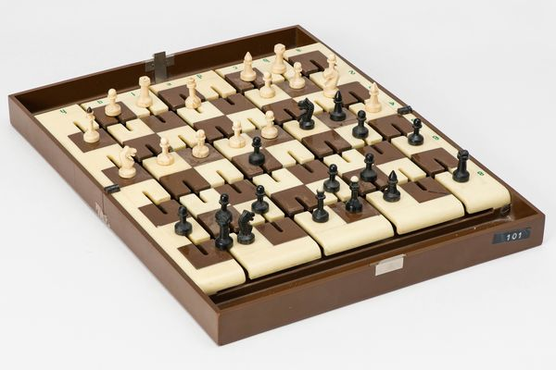
This special Russian chess set was developed in 1970. While magnets are usually used to achieve the desired effect, they were not used in this instance out of caution.
Who was this set built for, and why were magnets not used? (10)
17
18

Slide 70
Answer is...
17
18

Slide 71
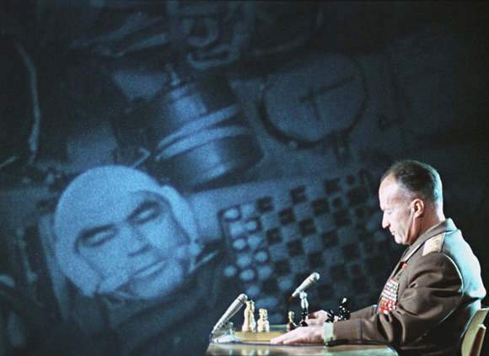
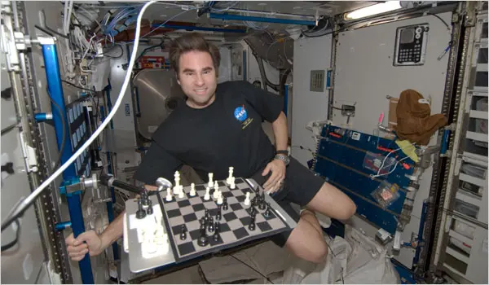
This set was built for cosmonauts aboard Soyuz 9, who famously played a game against their earth-based general in 1970.
Magnetic pieces were not, and still are not, allowed in zero gravity environments as they may interfere with instrumentation. Today’s sets typically use velcro.
17
18

Slide 72
Colossal, a venture by geneticist George Church, recently raised USD 15 million to turn back the clock - literally - on climate change. Church is best known for his work in synthetic biology, which involves “redesigning organisms by engineering them to have new abilities.” This project seeks to apply research on the genes that stimulate human hair growth to another animal. What biological feat is Colossal trying to achieve? (5)
Colossal aims to return the tundra to the state it was in 11,000 years ago to slow global warming. Counterintuitively, their solution involves regularly scraping away layers of snow that sit on top of the permafrost, which should slow the rate of methane emissions into the atmosphere. Why would scraping away snow help slow global warming? (5)
18
19

Slide 73
Answer is. . .
18
19

Slide 74
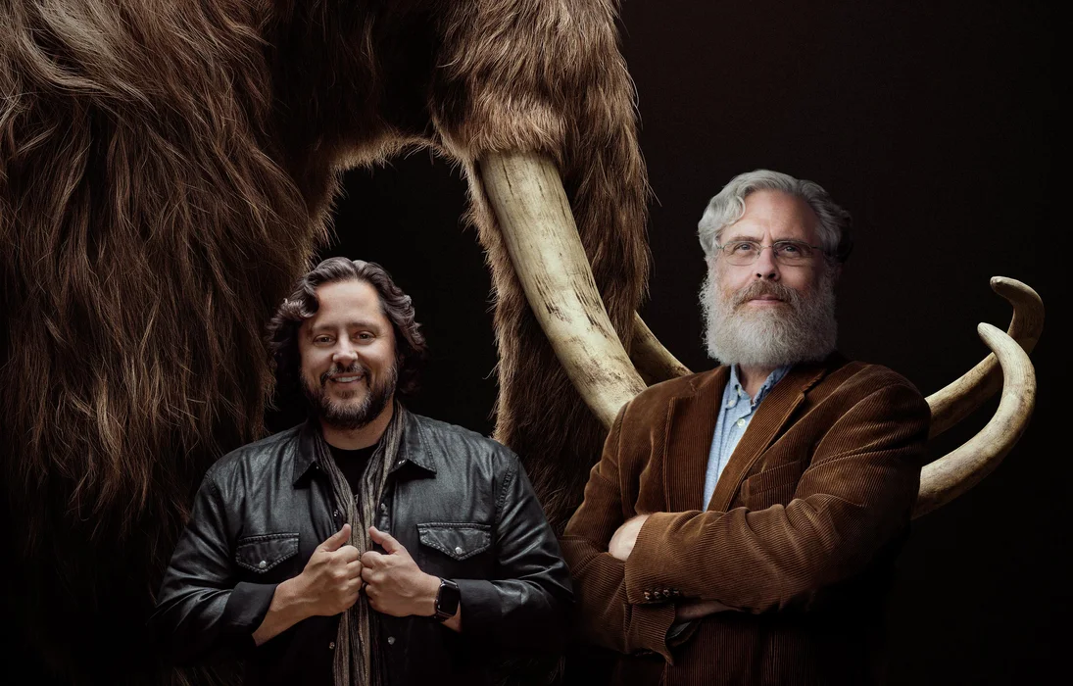
Colossal is trying to recreate the wooly mammoth by editing the genes of existing elephant species. The research on stimulating hair growth would be to make the elephant much hairier to survive in the tundra.
As mammoths walked through the tundra,
they used to displace the snow accumulated
on top of the permafrost. This allowed
cold Arctic winds to cool the permafrost. The
snow, however, acts as an insulating layer,
which prevents the permafrost from being
chilled by these winds, which hastens the possible release of hydrocarbons from permafrost melting.
18
19

Slide 75
The contraption at the center of the painting (A Philosopher Lecturing on the Orrery by Joseph Wright of Derby, 1766) is an orrery - a mechanical model of the solar system, with the sun as the point source of light at the center. While the moon is not part of the orrery, Wright of Derby relies on chiaroscuro to showcase the behavior of the moon.
How is the behavior of the moon depicted in the painting? (10)
19
20

Slide 76
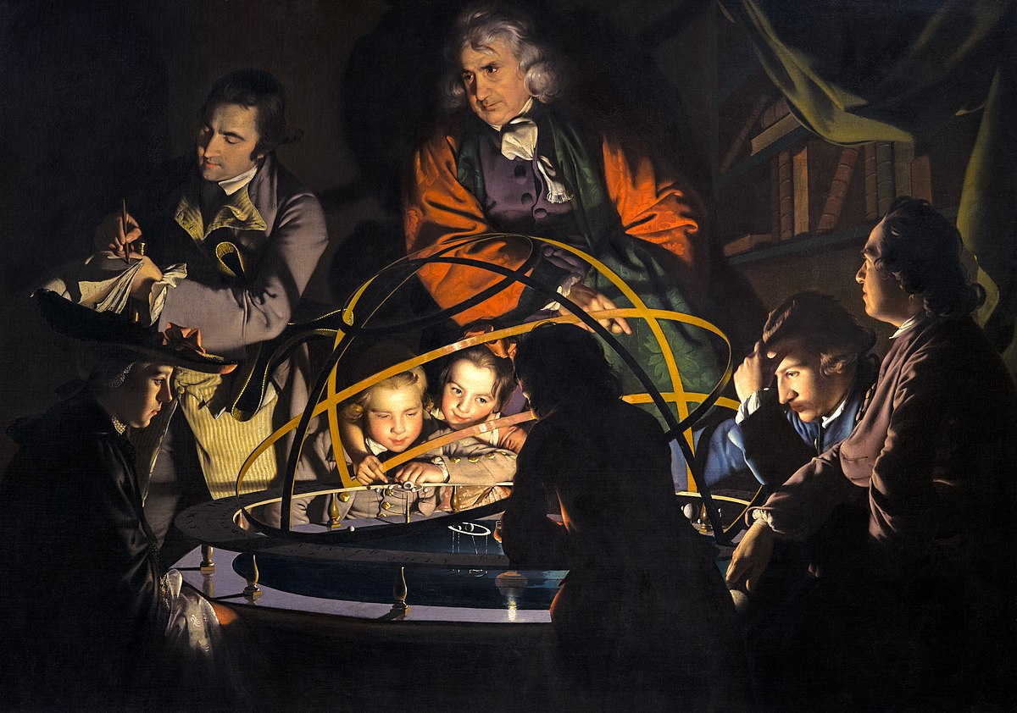
20
How is the behavior of the moon depicted in the painting? (10)

Slide 77
Answer is. . .
19
20

Slide 78
Light on the faces of the observers shows phases of the moon
19
20
Waning Gibbous
Waxing Crescent
Full Moon
Waxing Half
New Moon
Waning Half

Slide 79
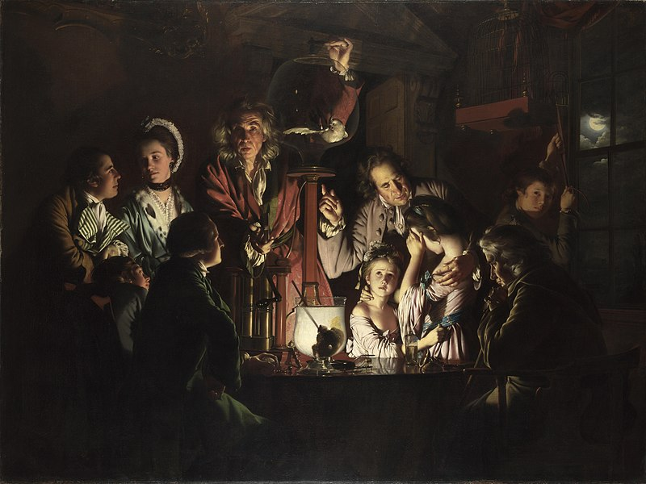
An Experiment on a Bird in an Air Pump (1768), recreating Robert Boyle’s vacuum pump experiment
19
20

Slide 80
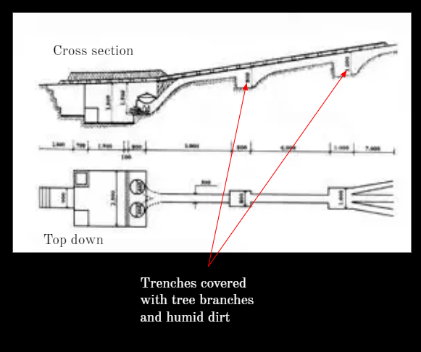
In the jungle, the Viet Cong and the FARC faced the same problem with an essential daily task. The VC living in the Cu Chi tunnels developed the setup (image), while the FARC engaged special personnel called hornilleros - derived from the Spanish horno, meaning ‘furnace’ – for the same task. What problem were they trying to solve?(10)
19
21

Slide 81
Answer is. . .
19
21

Slide 82
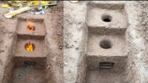
Cooking, sometimes for over 10,000 people, released a lot of smoke, which could be easily be used to track the location of these rebel groups. The Viet Cong and FARC worked extensively to design techniques to diffuse this smoke, so they left no trace of their whereabouts.
19
21

Slide 83
Penultimate question coming up - score check

Slide 84
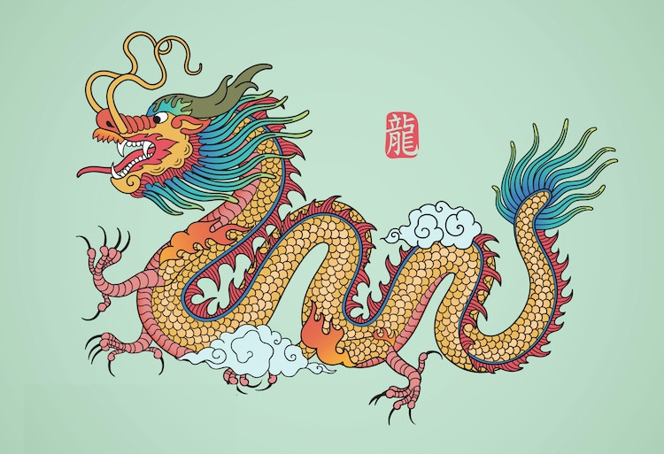
22

Slide 85
The unique aesthetic of the Chinese dragon - vis-a-vis dragons from other cultures - dates back to the reign of Huangdi in 2697 BC. Upon becoming the Yellow Emperor, Huangdi modified his totem - the dragon - to reflect that he had subsumed the other tribes in the Yellow River Valley. What approach did Huangdi take to reflect he had subsumed the other tribes? (5)
In 1906, San Francisco sought to relocate its Chinese immigrant population, unjustly claiming that Chinatown was unsanitary. To resist these pressures, immigrant leaders hired Western architects (who had never been to China) to redesign Chinatown. The architects added a prominent design element uniquely associated with temples, but now symbolic of Chinatowns globally. What did they add? (5)
22

Slide 86
Answer is...
20
22

Slide 87
Huangdi incorporated the totems of the other tribes onto the dragon, which is why the Chinese dragon incorporates features from other animals.
20
22
Whiskers of a catfish
Horns of a deer
Mane of a lion
Talons of a hawk
Scales of a fish
Body of a snake
Paws of a tiger

Slide 88
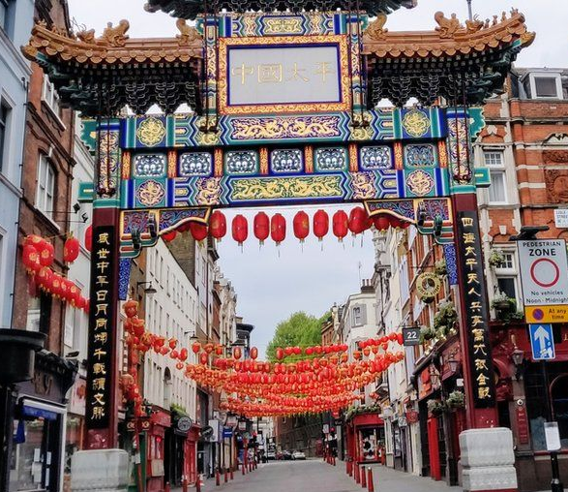
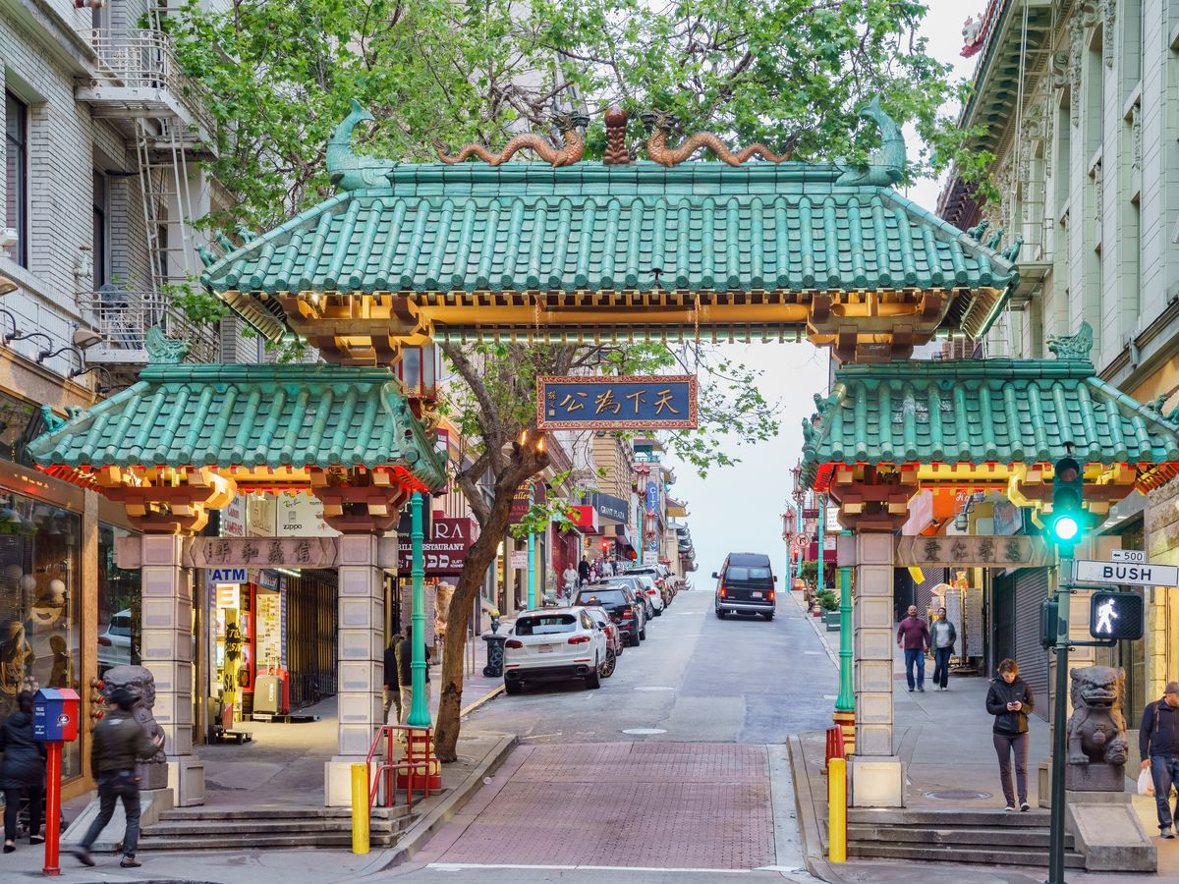
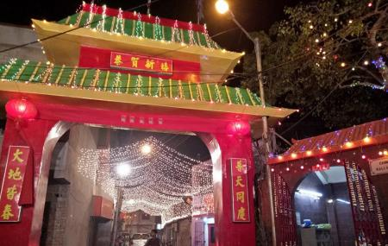
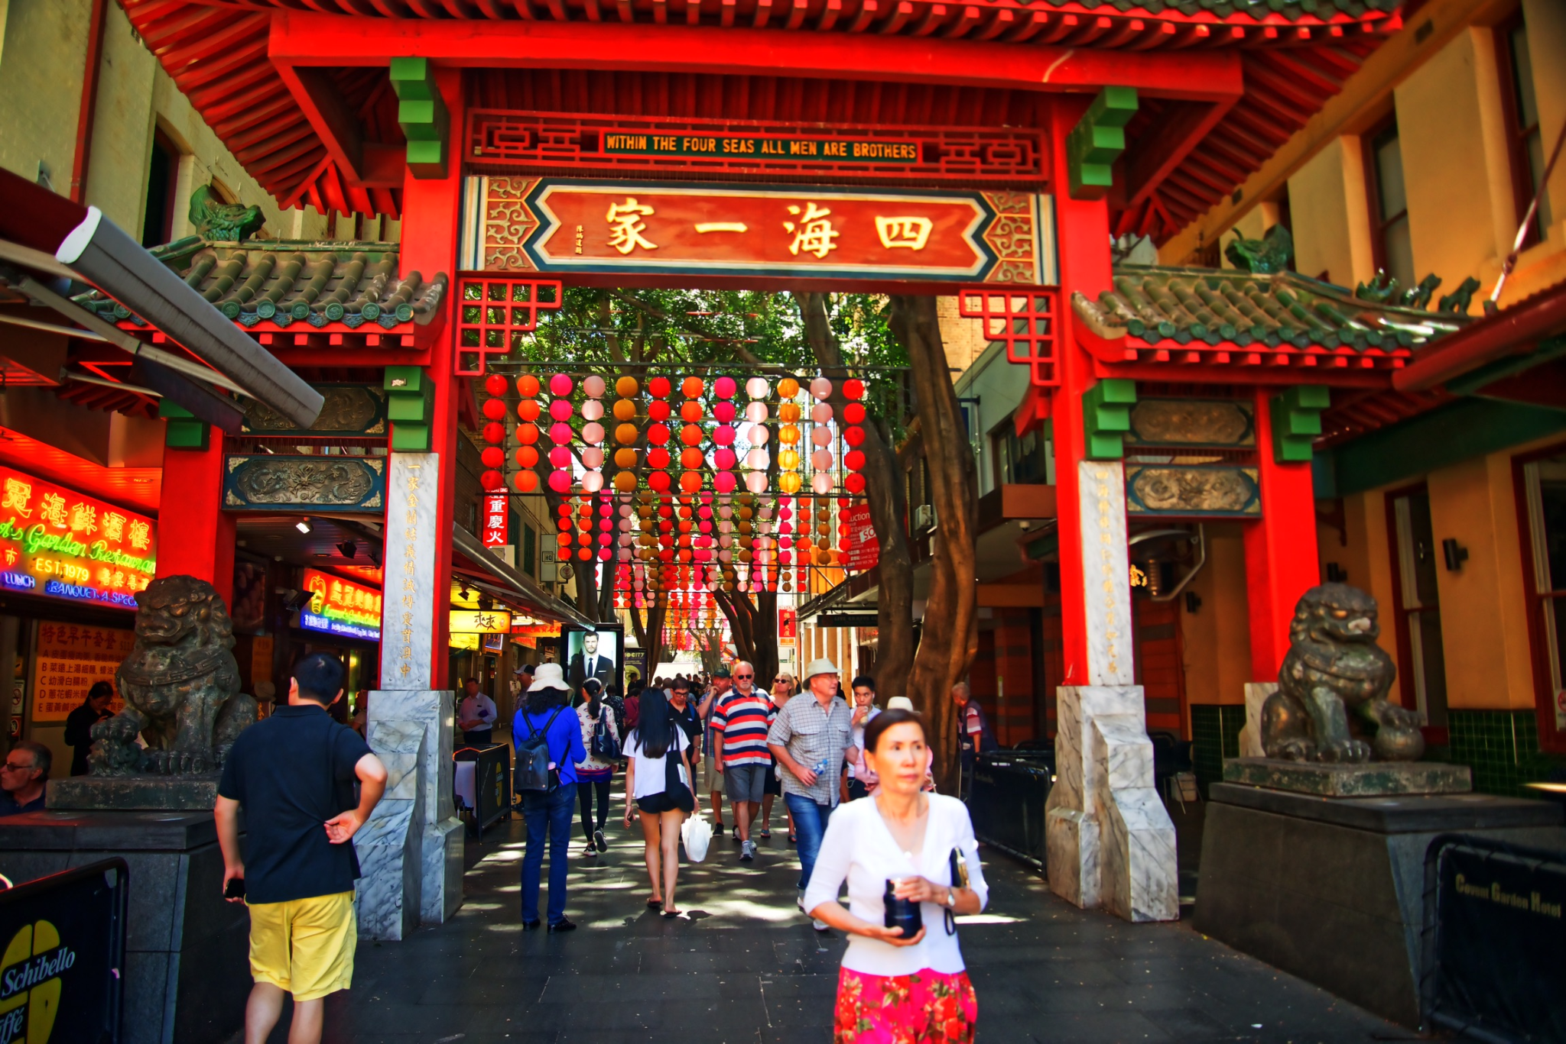
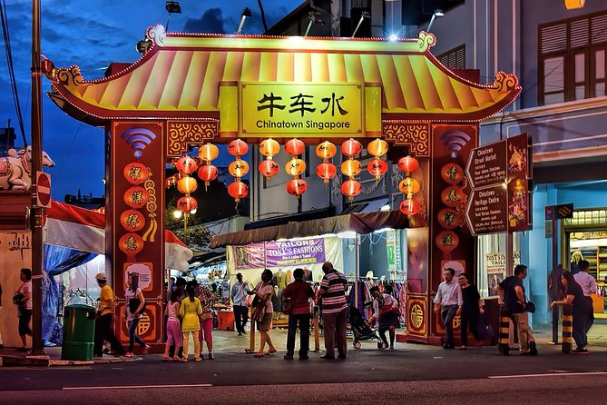
20
22
Kolkata
San Francisco
London
Sydney
Singapore

Slide 89
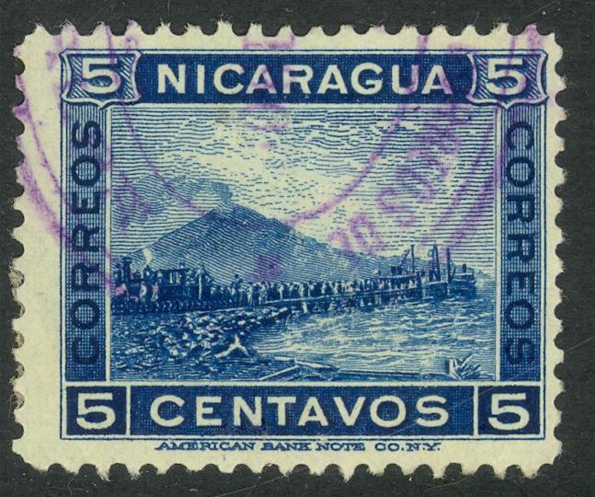
In the early 1900s, French engineer Philippe Buanu-Varilla sent every U.S. Senator this Nicaraguan stamp depicting Mount Momotombo. Having invested substantial money and time working on a project, he hoped the stamp would curry favor for this project with Congress.
Congress initially feared that financing this project would alienate an ally in Colombia. Nevertheless, it was eventually chosen.
What was the project? (5) Why did Buanu-Varilla choose to send this stamp to the Senators? (5)
21
23

Slide 90
21
23
What was the project? (5)?
Why did Buanu-Varilla choose to send this stamp to the Senators? (5)

Slide 91
Answer is. . .
21
23

Slide 92
The project is the Panama Canal.
Buanu-Varilla sent this particular stamp because of how Mount Momotombo was depicted. With smoke spewing out the top, the volcano appeared active, giving the impression the volcano could erupt.
The diplomatic concern was that Panama had recently split from Colombia. If America decided to pursue a project in Panama, it could jeopardize the U.S.’s diplomatic relationship with Colombia.
21
23

Slide 93
Thank you!

Slide 94
Standbys

Slide 95
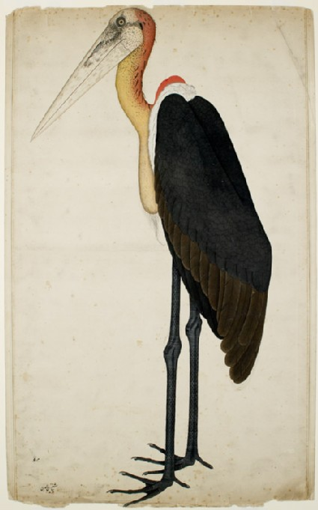
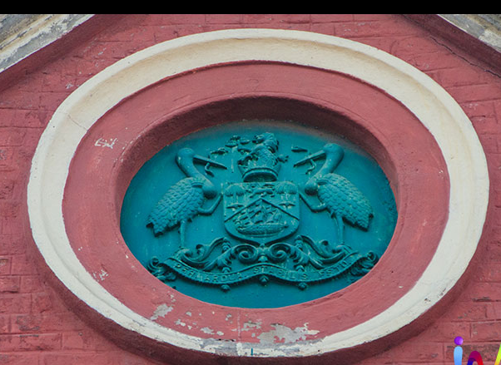
2

Slide 96
The Greater Adjutant is a scavenging bird that was widely found in Calcutta in the late 19th/early 20th century. Such was its efficiency, that an act was passed to protect them, with anyone injuring or killing a bird needing to pay a fine of ₹50. Aptly given this role, a pair of adjutants were added to the first coat of arms of an entity established in 1876 (image 2). Which entity (5)?
The painting of the Greater Adjutant (Image 1) was commissioned from Shaikh Zain ud-Din in 1777. Neither Zaid ud-Din nor his fellow painters were recognized as the painters of these artworks till a recent event “Forgotten Masters” looked into the history to give them their due. Who commissioned the paintings, and why were the painters not known? (5)
2

Slide 97
Answer is. . .

Slide 98
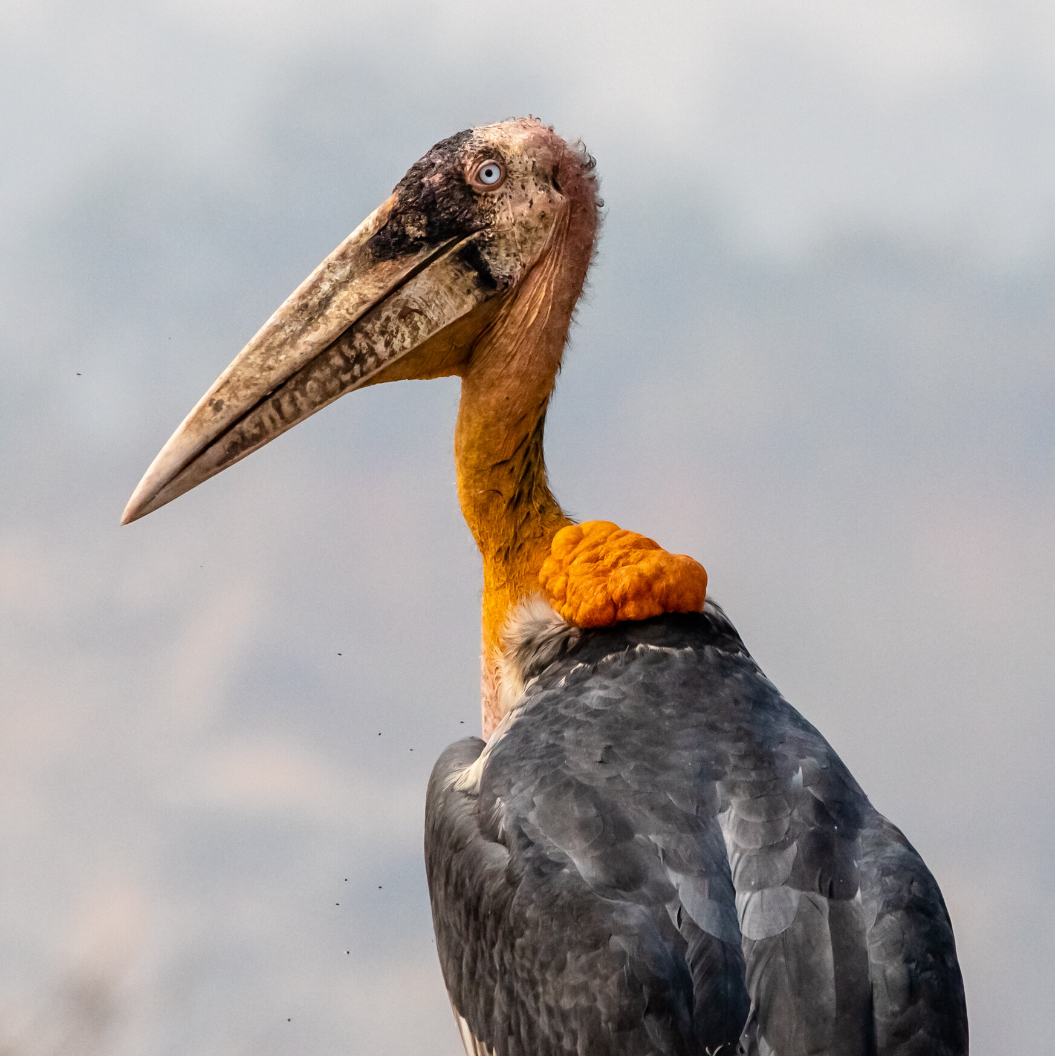
Kolkata Municipal Corporation
The paintings were commissioned by officials of the East India Company, and were often sold under the title “Company Art” - meaning that the original painters were not known till recently
2

Slide 99
As the Colombian Army procured surveillance technology and became more agile in the 2000s, the FARC had to change how they fed their 10,000 strong militia camped in the jungles.
To minimize risk of detection, the FARC created a new role: the hornillero. The term itself is derived from the Spanish word horno, meaning “furnace”. Before surveillance, the FARC avoided the need for a hornillero by setting up stations near very large trees. But now, with the FARC’s use of new portable equipment, and with no guarantees on where the next camp would be, a specialist was needed.
What was the specific job of the hornillero? (10)
3

Slide 100
Answer is. . .

Slide 101
The hornillero was responsible for designing methods to diffuse the smoke that was emitted when cooking on portable gas stoves, so the Army could not track the movements of the FARC from the skies. Large trees diffused the smoke naturally.
3

Slide 102
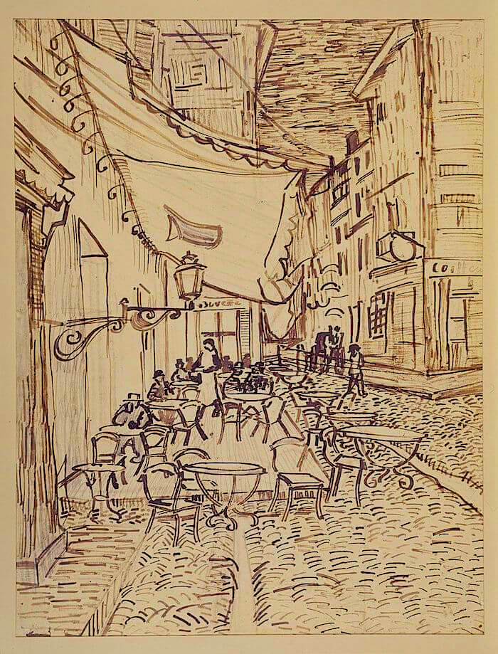

24
Cafe Terrace at Night (sketch - L, and final painting - R), Vincent Van Gogh

Slide 103
Cafe Terrace at Night was one of Vincent Van Gogh’s paintings from his time in Arles in the 1880s. A comparison between the sketch and the painting reveals changes Van Gogh made to the work, notably (i) the addition of a dark figure at the doorway at the edge of the painting; and (ii) a reworking of the number of diners at the cafe and their positions.
Art historians have argued these changes were intended as a tribute by Van Gogh to another painter (imitation being the sincerest form of flattery). This symbolism would also tie with Van Gogh’s own spiritual re-awakening detailed in correspondence with his brother Theo.
Who is the other painter, and how does Van Gogh pay them a tribute? (10)
24

Slide 104
Answer is...
24

Slide 105


24

